Slide 1

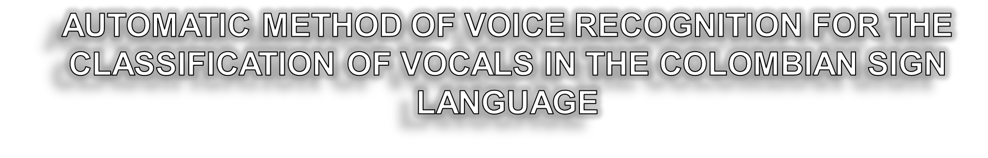

Tutor: Roger Guzman

Slide 2

PROBLEM DEFINITION
OBJECTIVE
DATASET CONTRUCTION AND REVISION
STATE OF ART REVISION ALGORITHMS

Slide 3

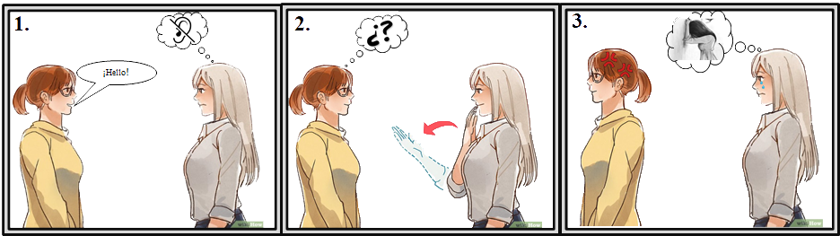

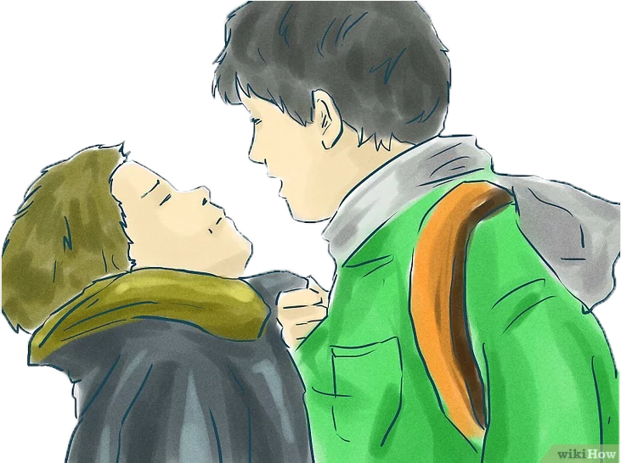



Slide 4
OBJECTIVE
Implement an automatic classification method using machine learning for the interpretation of vocal sounds in Colombian sign language symbols.
Construct a data set of vowel sounds with their respective labels.
Develop a strategy of processing, sampling and classification of vowel sounds using machine learning for visual representation in Colombian sign language.
Compare three methods of classifying vowel sounds, using performance measures such as precision, recall and F1 Score.

Slide 5
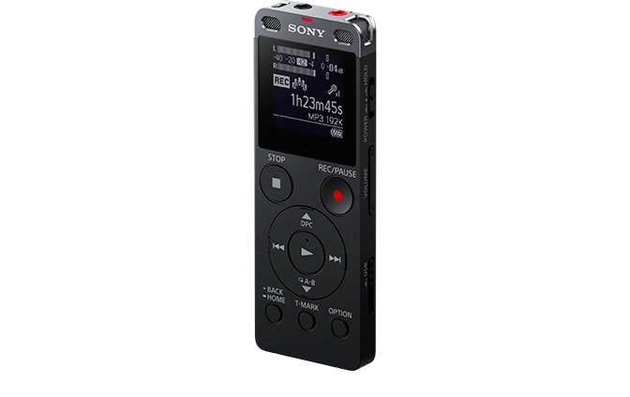
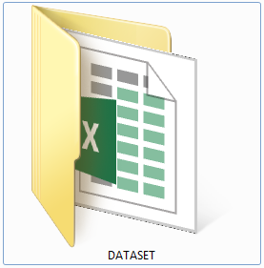

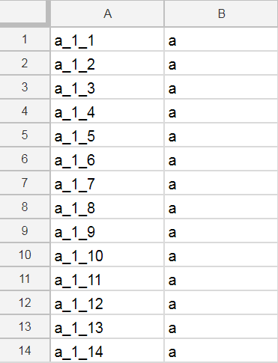




40
30
210
210
210
210
210

Slide 6
Voice Recognition
Pre Processing
Feature Extraction
Sampling
Clasification
Fourier Transform
Predictive Linear Coding
Cross Validation k-fold
Support Vector Machine
Fast Fourier Transform
Mel Cepstral Coefficients
Cross Validation Leave One Out
Neural Network
Wavelet Transform
Random
Cross validation
Hidden Markov Model
Discrete Cosine Transform

Slide 7


